Slide 1

Ph.D. Proposal Examination
DNN-based Wildfire Detection, Prediction
and Tracking with UAV
By: Linhan Qiao
Supervisor: Dr. Youmin Zhang
Department of Mechanical, Industrial and Aerospace Engineering
December 11, 2021

Slide 2
Outlines
Introduction
Related Works
Objectives
Methodologies
U-net-based Wildfire Detection
Squeeze Model and Attention Gate
Cellular Automata-based Wildfire Prediction
VOT-based Wildfire Tracking
GAN-based Wildfire Image Restoration
Anticipated Significance of the Work
Timeline
Process to Date

Slide 3
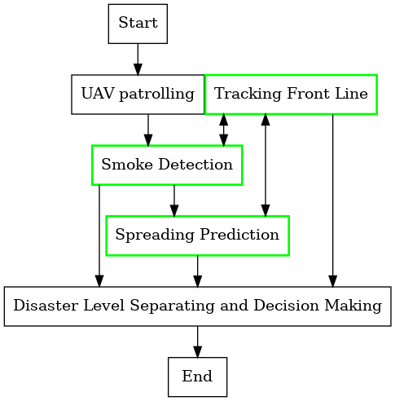
1. Introduction
The concept of wildfire management is more accepted
UAV is efficient in wildfire fighting
Feature-learning of DNN is appropriate to this mission at such background
Wildfire tracking and prediction is needed for understanding fire behavior and as guiding decision making for fire-fighters
How might a DNN-based wildfire detection, prediction and tracking strategy work for UAV-based wildfire management and fighting?

Slide 4
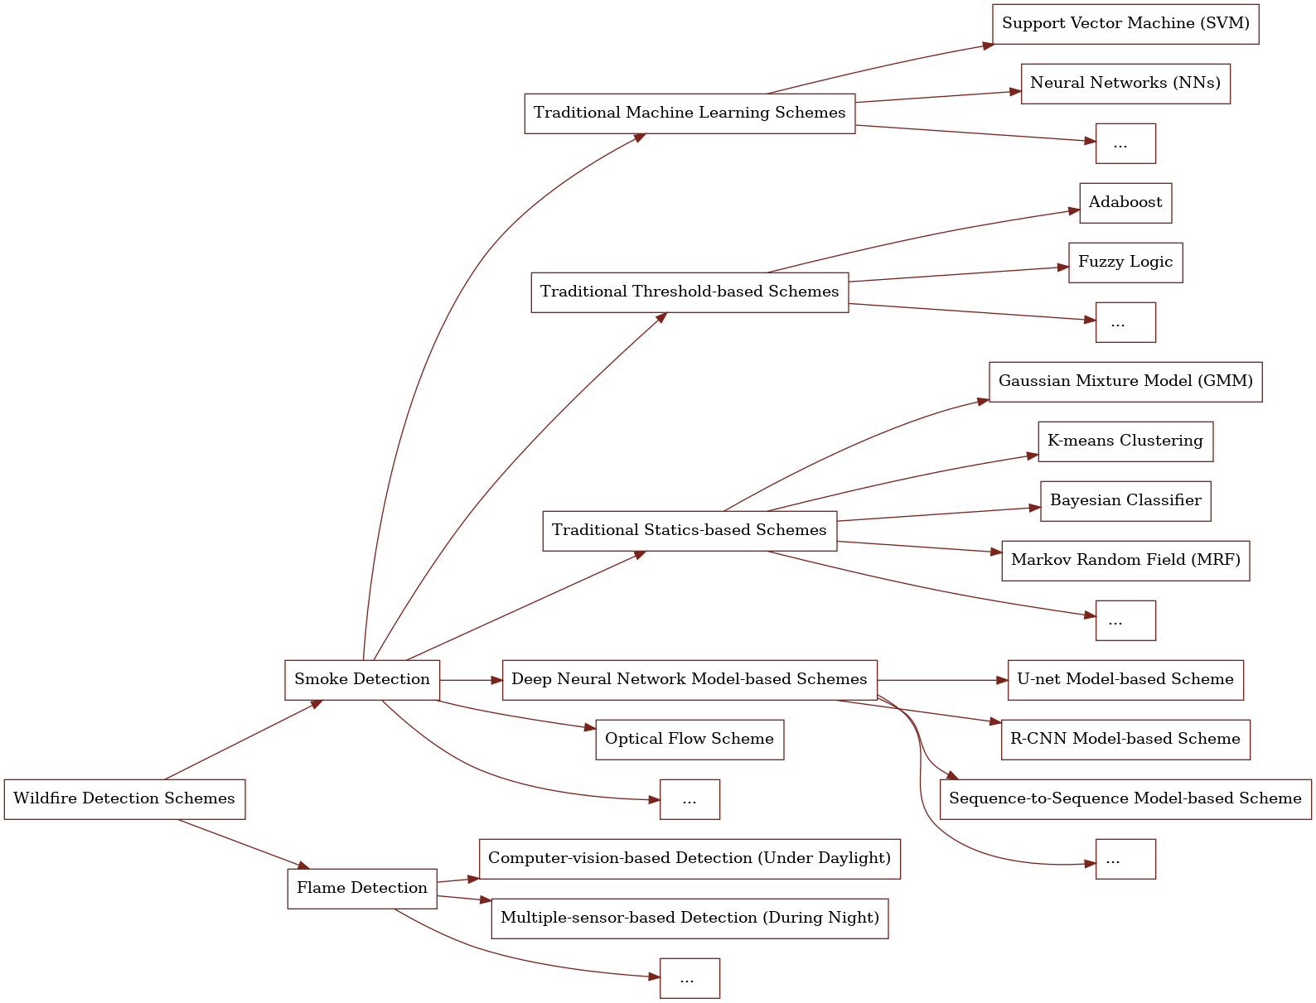
2. Related Works
Appliable Wildfire Detection Schemes with UAV
Fast enough for early detection
Understand higher-level features of smoke and flame
Computational saving for on-board computer

Slide 5
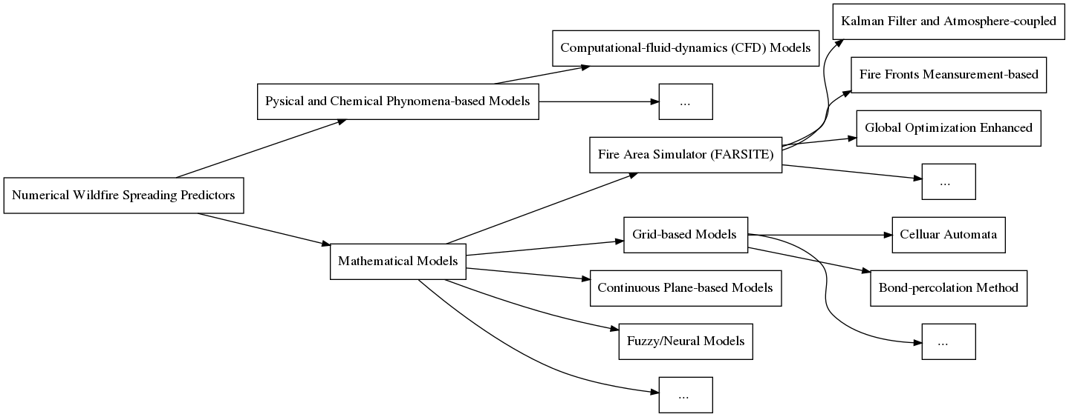
2. Related Works
Appliable Wildfire Prediction Schemes
Easier to be deployed for different forest area
Able to describe the wildfire dynamics
More mathematical but not reply too much on experience

Slide 6
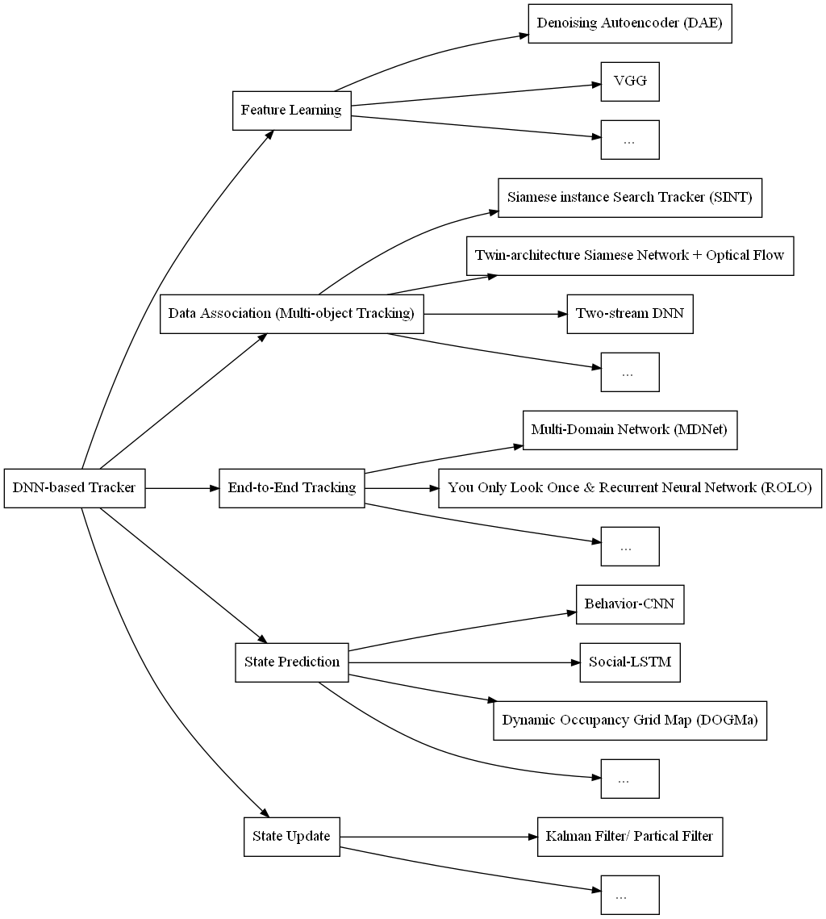
2. Related Works
Consists of Vision-based Wildfire Tracking
Fast enough
Detection process appliable

Slide 7
3. Objectives
Detection objective | Design and develop wildfire classification and segmentation schemes for ground workstation and on-board computer of UAV.
Prediction objective | Based on Cellular automata to develop a wildfire spreading model for ground workstation.
Coverage and tracking objective | Design and develop multiple wildfire fronts tracking scheme for on-board computer of UAV.

Slide 8
4. Methodologies
U-net-based Wildfire Detection
RGB video streams, Infrared camera information
It is such designed as considering:
On-board: ResNet18-based classification (limited accuracy)
U-net is appropriate for complex sematic segmentation.
ResNet structure performed best in most competitions in recent years.
On-board: U-net-based segmentation (ResNet18-based or even lighter-weight)
Ground: U-net-based segmentation (ResNet34 structure, Fastai API)
SqueezeNet modules decrease the parameter size a lot.
Attention gate is helpful in decreasing false positive.
Optimization:
Faster detection – Modules of SqueezeNet
False positive problem – Attention mechanism
Fastai is helpful in fast fine-tunning the network.
On-board co-operate with:
Path planning of UAV, control of Gimbal, …

Slide 9
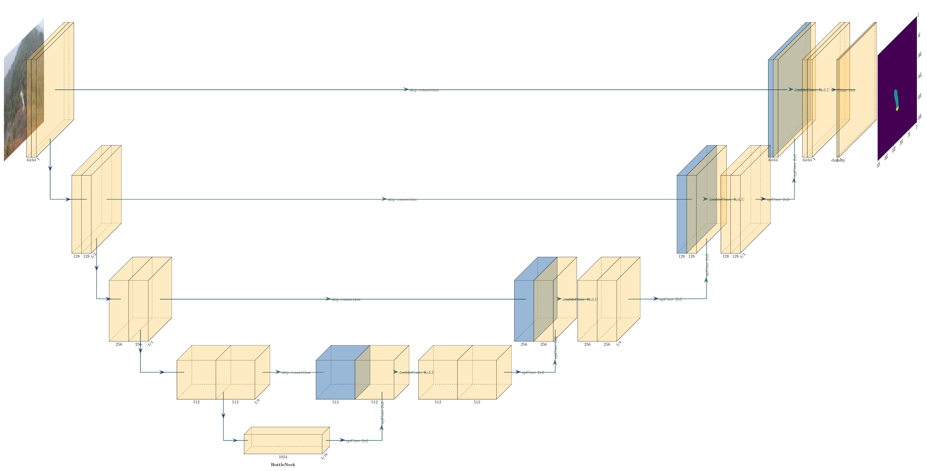
4. Methodologies
U-net-based Wildfire Detection
ResNet18-based U-net for wildfire segmentation

Slide 10
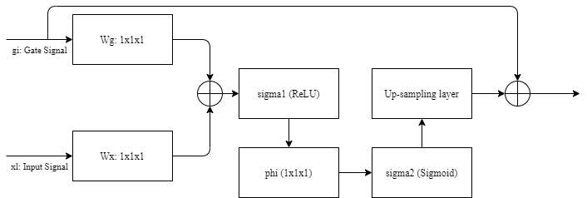
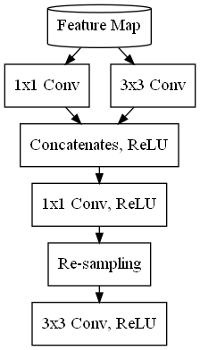
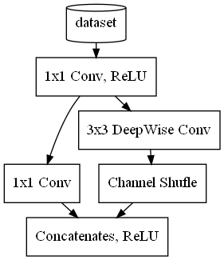
4. Methodologies
U-net-based Wildfire Detection
Attention gate addictive for skip connections
Developed ResNet18-based U-net with attention gates and SqueezeNet modules for wildfire segmentation
Unsqueeze module to replace double transpose Conv layers in decoder part.
Squeezed module to replace double Conv layers encoder part.

Slide 11
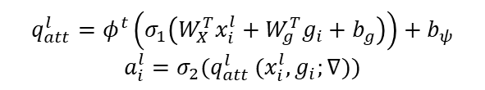
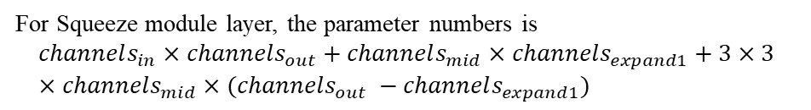
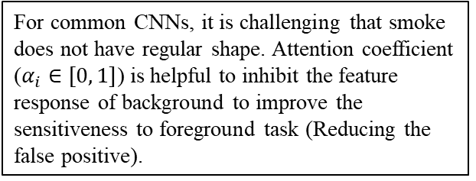
4. Methodologies
U-net-based Wildfire Detection
For common CNNs, it is challenging that smoke does not have regular shape. Attention coefficient ($α_{i}∈[0, 1]$) is helpful to inhibit the feature response of background to improve the sensitiveness to foreground task (Reducing the false positive).
$$q_{att}^{l}=φ^{t}\left(σ_{1}\left(W_{X}^{T}x_{i}^{l}+W_{g}^{T}g_{i}+b_{g}\right)\right)+b_{ψ}$$
$$a_{i}^{l}=σ_{2}(q_{att }^{l}(x_{i}^{l}, g_{i};∇))$$
Attention gate addictive for skip connections
Where $W_{g}, W_{x},φ$ are $1×1×1$convolution; $b_{g}, b_{φ}$are related biases; $σ_{1}$ is the ReLU activation; $σ_{2}$ is the sigmoid activation. The out put of attention gate module is the element-wise multiplication of gate signal and attention coefficient.
In_channels = 64, Out_channels = 128, Mid_channels = 75, expand1_channels = 15 | Out_channels = 128
Common doubleConv | 221184
Squeeze module | 82200
For common doubleConv layer, the parameter numbers is
$$3×3×channels_{in}×channels_{out}+3×3×channes_{out}×channels_{out}$$
For Squeeze module layer, the parameter numbers is
$$channels_{in}×channels_{out}+channels_{mid}×channels_{expand1}+3×3×channels_{mid}×(channels_{out} −channels_{expand1})$$
Comparison of parameter numbers of down-sampling layer

Slide 12
4. Methodologies
CA-based Wildfire Prediction
Historical wildfire and environment dataset
It is such designed as considering:
CA could be designed for describing the wildfire dynamics.
Processing the rate of spreading (ROS) equation
ROS could describe the relationship between spreading rate and the impacts of wind, vegetation and topography.
DNN regression for burning probability of cellular automata (CA)
DNN optimize parameters of spreading (ROS) of fire
DNN (attention mechanism) could optimize the parameters of ROS with lower computational complexity
States and rules of CA

Slide 13
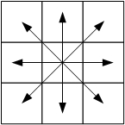
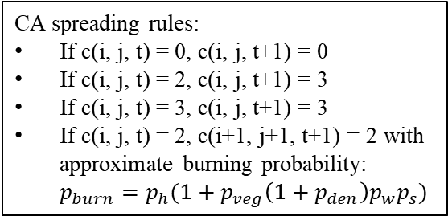
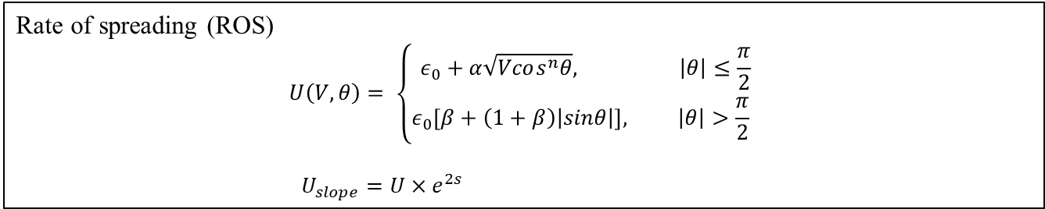
4. Methodologies
CA-based Wildfire Prediction
Cellular automata (CA)
CA spreading rules:
If c(i, j, t) = 0, c(i, j, t+1) = 0
If c(i, j, t) = 2, c(i, j, t+1) = 3
If c(i, j, t) = 3, c(i, j, t+1) = 3
If c(i, j, t) = 2, c(i±1, j±1, t+1) = 2 with approximate burning probability: $p_{burn}=p_{h}(1+p_{veg}\left(1+p_{den}\right)p_{w}p_{s})$
Cell states:
0, not any fuel;
1, contains fuel but not ignited;
2, contains fuel and is burning;
3, contains fuel and is burnt down.
Possible spreading directions
Rate of spreading (ROS)
$$U\left(V, θ\right)= \left\{\begin{aligned}ε_{0}+α\sqrt{Vcos^{n}θ}, \left|θ\right|≤\frac{π}{2} \\ ε_{0}\left[β+\left(1+β\right)\left|sinθ\right|\right], \left|θ\right|>\frac{π}{2} \end{aligned}\right.$$
$U_{slope}=U×e^{2s}$
Optimization of parameters $\left[ε_{0}, α, n, β, s\right]$ of ROS, and more specific burning probability of CA.

Slide 14
4. Methodologies
VOT-based Wildfire Tracking
It is such designed as considering:
Image information from UAV
Tracking is based on previous detection works.
Attention mechanism of classifier of detection would be less computational complex.
DNN-based wildfire detection
On-board classification
On-board segmentation
IOU match would be fast enough for on-board computing.
KF predict
Intersection over union (IOU) matching
Accuracy of IOU matching is relying on detection.
Un-matched track
Un-matched detection
Delete
Matched track
KF update

Slide 15
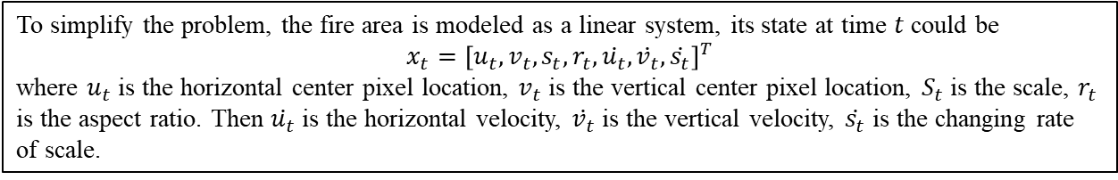
4. Methodologies
VOT-based Wildfire Tracking
To simplify the problem, the fire area is modeled as a linear system, its state at time $t$ could be
$$x_{t}={\left[u_{t}, v_{t}, s_{t}, r_{t}, \dot{u_{t}}, \dot{v_{t}}, \dot{s_{t}}\right]}^{T}$$
where $u_{t}$ is the horizontal center pixel location, $v_{t}$ is the vertical center pixel location, $S_{t}$ is the scale, $r_{t}$ is the aspect ratio. Then $\dot{u_{t}}$ is the horizontal velocity, $\dot{v_{t}}$ is the vertical velocity, $\dot{s_{t}}$ is the changing rate of scale.

Slide 16
4. Methodologies
VOT-based Wildfire Tracking

Slide 17
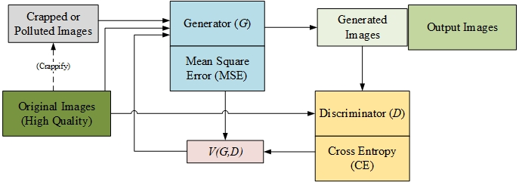
4. Methodologies (Additional)
GAN-based Wildfire Image Restoration
Generative adversarial network (GAN) could be considered as a balancing process between U-net-based generator (G) and classifier discriminator (D).
It should only be applied at emergent situation as ensure the safety of UAV in serious wildfire environment when signal is missing or heavily polluted.

Slide 18
5. Anticipated Significance of the Work
The merits of this proposed research can be reflected by an anticipated significant contribution to the concept of smart forestry, especially the UAV-based forest firefighting. It is an essential work to improve the wildfire detection and location accuracy with UAV during the early fire period. The main idea of this work is to save the limited computational resource on-board and decrease the false positive in wildfire detection. The results of the proposed work would be published in journal and conference publications.
Main contributions of this work might be to
Develop the performance of U-net-based segmentation on-board by designing novel modules and applying attention mechanism.
Develop the CA-based wildfire spreading model by optimizing parameters of ROS.
Balance the tracking speed and accuracy on-board by applying IOU matching based on detection at front step.

Slide 19
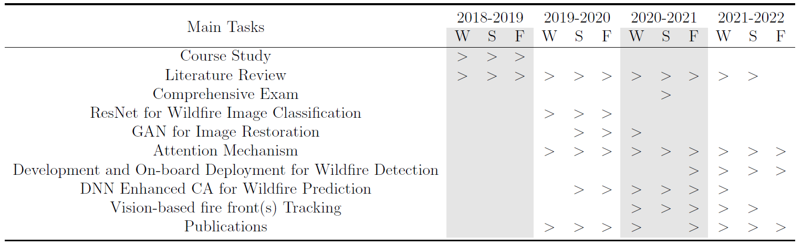
6. Timeline
Publications
[1] L. Qiao, Y. Zhang, and Y. Qu, “Pre-processing for UAV based wildfire detection: A loss u-net enhanced GAN for image restoration,” in IEEE International Conference on Industrial Artificial Intelligence(IAI), Shenyang, China, 2020
[2] L. Qiao, Y. Zhang, and Y. Qu, “UNet-based wildfire segmentation with Fastai,” finished

Slide 20
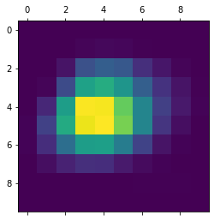
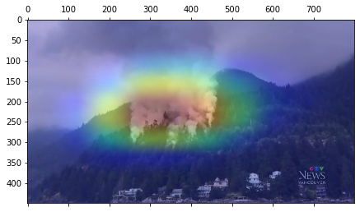
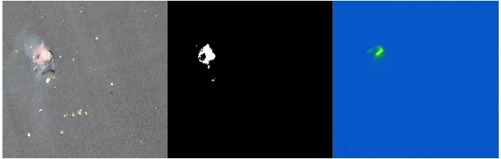
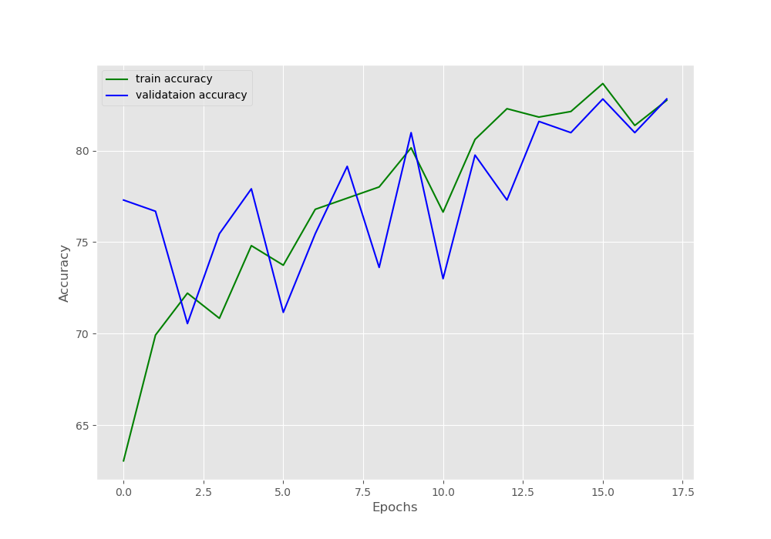
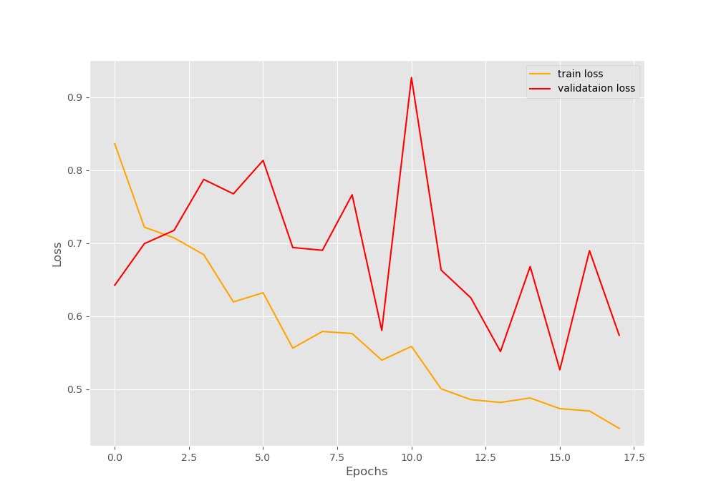
7. Process to Date
Resnet18 U-net with tensorRT online segmentation for on-board computer (experiment 1)
Grad cam classification for on-board computer (simulation)
Accuracy and loss changing of ResNet18 classification for on-board computer (preparing for experiment 2)

Slide 21
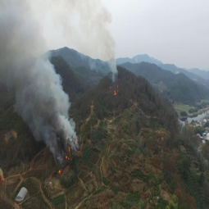
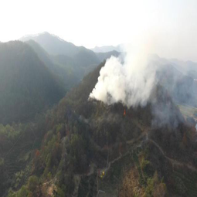
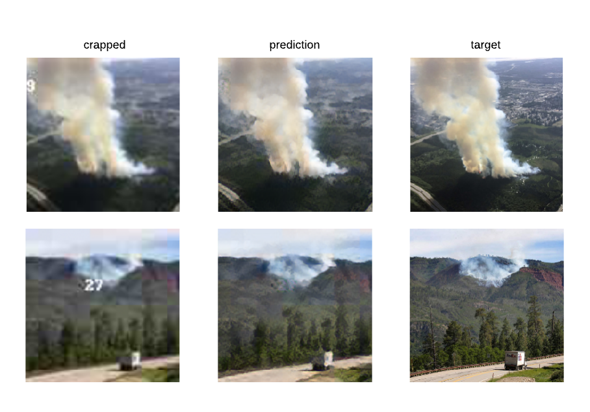
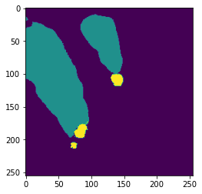
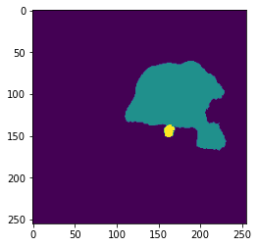
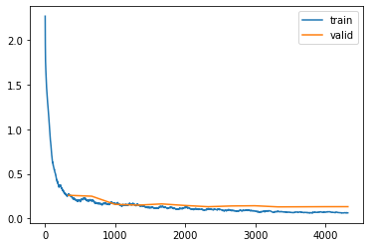
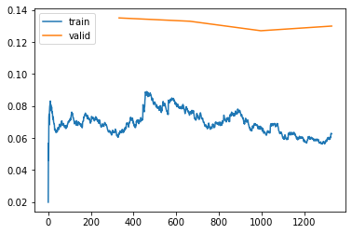
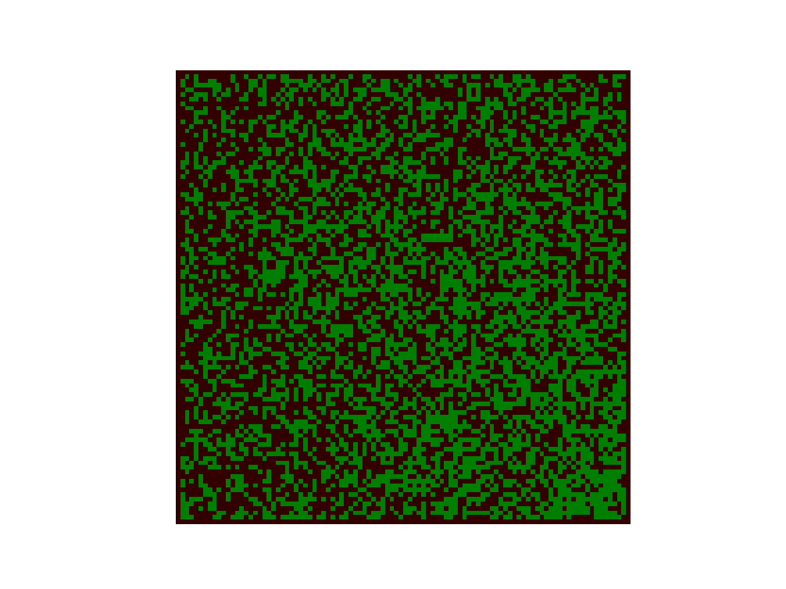
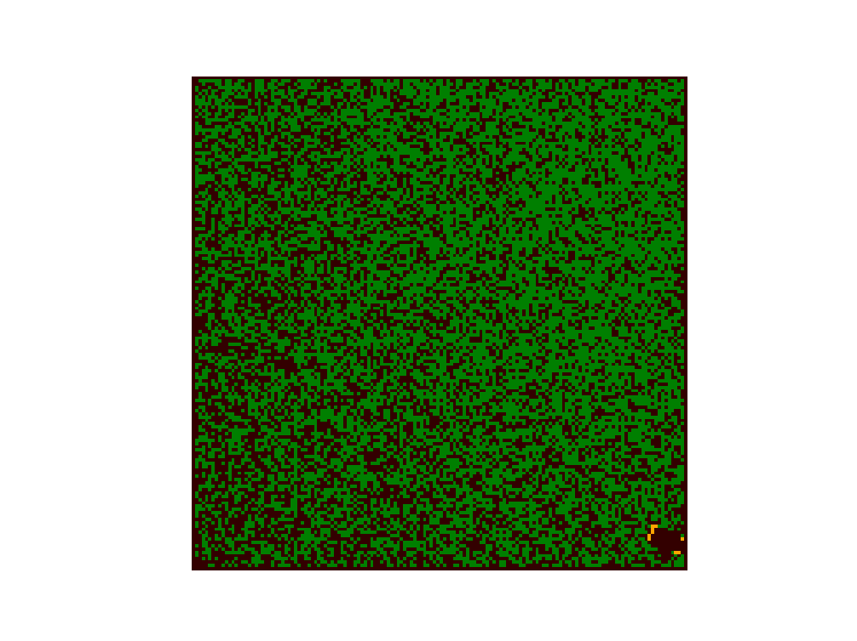
7. Process to Date
Resnet34 U-net segmentation for ground workstation (simulation with experiment dataset)
GAN-based wildfire image restoration (simulation)
Single and multiple fire points spreading prediction of CA for ground workstation (simulation)
Loss changing of Resnet34 U-net training, accuracy 95%

